Slide 1
UNIT –FOUR
PART-TWO

Slide 2
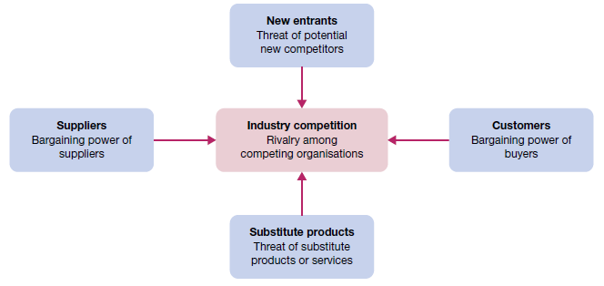
Porter’s model of five strategic forces affecting industry competition

Slide 3
Michael Porter's Five Forces is a powerful competitive analysis tool to determine the principal competitive influence in a market.
Knowing the strength of these five forces, you can develop strategies that help their businesses be more competitive and profitable.
Looking at opportunities, you can to strengthen their organization's position compared to the other players for reducing the competitive pressure as well as generate competitive advantage.

Slide 4
Step-by-Step Five Forces Analysis
Identify the different factors that bring about the competitive pressures for each of the five forces:
Who are the suppliers?
Who are the customers?
What are the substitute products?
Is it difficult to enter this industry?
Who are the major competitors in this industry?
Based on the factors identified, determine if the pressures are:
Strong
Moderate
Weak
Determine whether the strength of the five forces is favorable to earning attractive profits in the industry. Using the Five Forces model can help answer the following questions:
Is the state of competition in the industry stronger than "normal"?
Can companies in this industry expect to earn decent profits in light of the competitive forces?
Are the competitive forces sufficiently powerful enough to undermine industry profitability?

Slide 5
The bargaining power of suppliers:
The market is conquered by a few big suppliers.
There are no alternative products available.
The supplier customer base is fragmented, making their bargaining power low.
High switching costs from one to another supplier.
Possibility of supplier integration forward, to obtain higher profits and margins.

Slide 6
The bargaining power of Customers:
Customers procure large volumes.
The supplying industry consists of several small operators.
The supplying industry is controlled with high fixed costs.
The product has substitutes. Switching products is easy and simple.
Switching products does not incur high costs.
Customers are price responsive. Customers could manufacture the product themselves.

Slide 7
The threat of new entrants
Economies of scale. High initial investment costs or fixed costs
Cost advantage of existing players.
Brand loyalty.
Intellectual property like licenses, etc.
Shortage of important resources.
Access to raw materials is controlled by existing players.
Distribution means are controlled by existing players.
Existing players have secure customer relations. Elevated switching costs for customers.
Legislation and government acts.

Slide 8
The threat of substitutes:
Brand dependability of customers.
Secure customer relationships.
Switching costs for customers.
The relative price for performance of substitutes.
Up-to-date trends.

Slide 9
Competitive rivalry:
Players are the same size.
Players have comparable strategies.
Little or no differentiation between players and their products leading to price competition.
Low market growth rates.
Barriers for exit are high.

Slide 10
Porter's Five Forces Example - Footwear Company
The bargaining power of suppliers
The bargaining power of customers
wholesale customers
they can switch
at a low cost to the competition
as customers are loyal to the brand.
The threat of new entrants
The threat of substitute
The competitive rivalry

Slide 11
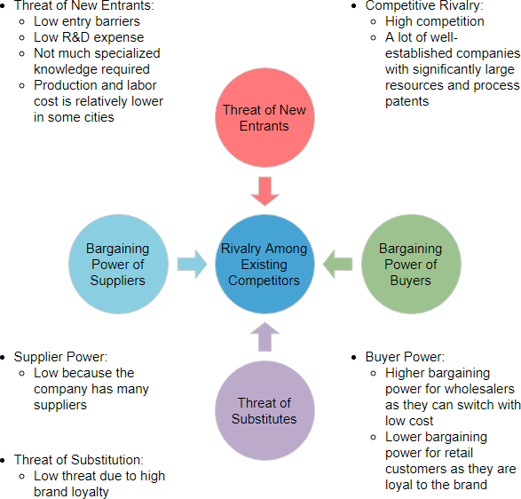

Slide 12
The effect on Internet on Porter's 5 forces model
The entry of new competitors
Digital business changes the rules by lowering the traditional barriers to entry. A digitally based business model requires far less capital and can bring large economies of scale for example

Slide 13
The threat of substitutes
The threat of substitutes is high in many industries since switching costs are low and buyer propensity to substitute is high. In the taxi services example, customers can easily switch from traditional models to the new model simply by installing an app on their smartphone. Propensity to switch from the traditional model is high due to consumer wait times for taxis, lack of visibility into taxi location and so on.

Slide 14
The bargaining power of buyers
Customers and consumers have amassed far more bargaining power today due to instant access to information, insights from social media including access to reviews and feedback, low switching costs via digital channels, price sensitivity, access to substitute products and services with greater ease of use and convenience, as well as increased industry competitiveness as a result of the other forces.

Slide 15
The bargaining power of suppliers
Suppliers can accelerate or slow down the adoption of a digitally based business model based upon how it impacts their own situation.

Slide 16
The rivalry among the existing competitors
The rivalry is heating up because entry and exit barriers are going down due to the comparative low-cost of internet business models, and in many cases new entrants do not even need to own physical assets or infrastructure.

